Slide 1
Sophos EDR Data Lake
Early Access Program

Slide 2
Summary
The XDR and EDR Data Lake Early Access Program will (on enrolled endpoint and server devices) run scheduled Sophos managed threat hunting focused queries. The results of queries will be stored in a new customer data lake and this data is currently queryable via APIs and also via our Live Discover functionality in Sophos Central. The Data Lake will include XG Firewall data if Central Firewall reporting is enabled. A query test tool and some test scripts will be provided for admins who prefer to query the Data Lake via APIs. Having this data available in the Data Lake means that customers will be able to threat hunt using this offline data regardless of the actual state of the device. Admins will have the ability to:
Query device information even when it is offline or destroyed
Correlate information between devices and XG Firewall data
Track lateral movement between devices
Use data lake queries to search for Indicators of compromise across all devices without generating CPU load on the devices
Throughout the EAP we plan to introduce some exciting new functionality into Sophos Central to allow customers to:
Introduce pivot capabilities to start a new query from an existing query
Data enrichment on query results
Provide One-Click actions from query results

Slide 3
About the Early Access Program and Pre-Requisites
At this point in the EAP we are supporting just Windows Endpoints and Windows and Linux Servers
There will be an Early Access Program for both Endpoints and Servers and you must join one or both Early Access Programs to access the new features
New features will only be available to devices enrolled in the Early Access program
Customers don’t need an EDR license to enroll in the Data Lake EAPs, for customers who don’t have an EDR license we don’t provide an EDR license, but the Live Discover feature will become available and we will install the Live Discover components to devices that are enrolled in the EAPs.
New Sophos customers can start a new Central trial to get access to Intercept X with EDR for both endpoints and servers and then join the EAP.
Devices can only be enrolled to one Endpoint or Server early access program at a time
Three activities are required to join early access program
  Prepare devices
  Enter the Early Access Program(s) in Sophos Central
  Manage Devices and Confirm deployment
This deck aids to undertake these activities
Note: Use of all features and functionalities provided under the Early Access Program is subject to the Sophos End User License Agreement

Slide 4
1. Prepare devices
Check list for qualifying devices
  Devices eligible to be deployed to the early access program must be running the Central Endpoint or Server EDR software.
  Devices should have a Green health status displayed in your Sophos Central console

Slide 5
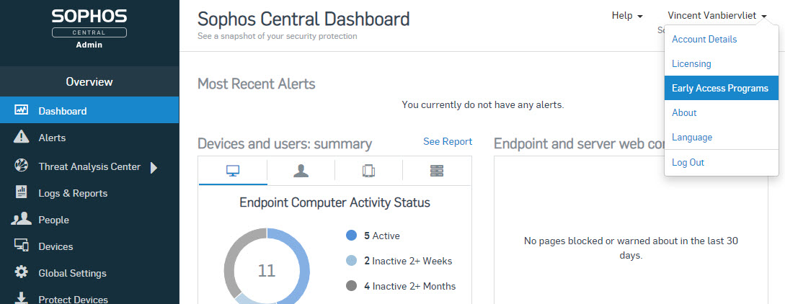
2. Entering the Early Access Program
Log into Sophos Central
Click on your name at the top right corner
Click on Early Access Programs

Slide 6
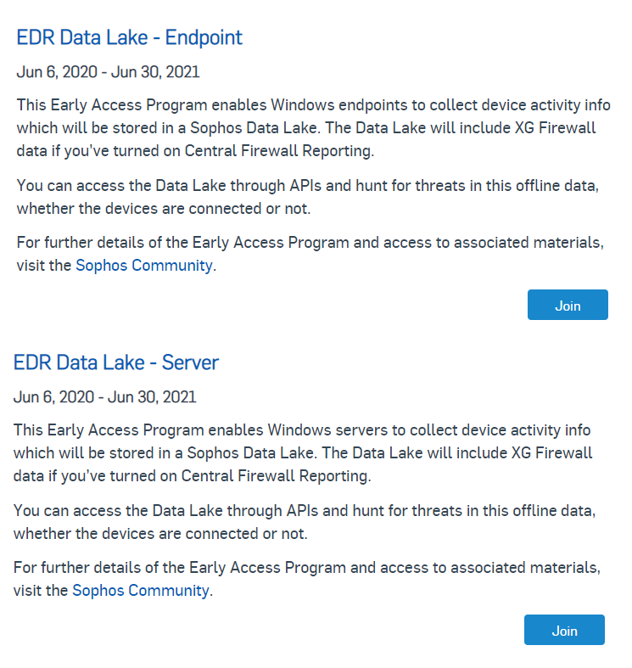
2. Entering the Early Access Program
You will now see the Early Access Programs screen
Depending on the EAP you want to join, select the “EDR Data Lake –Endpoint” or the “EDR Data Lake - Server” EAP
Click the button to Join the EAP

Slide 7
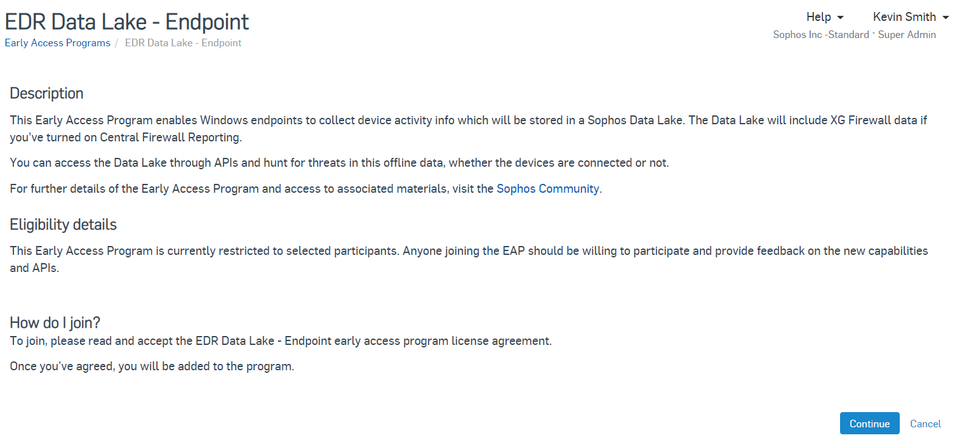
2. Entering the Early Access Program
Click Continue on the EDR Data Lake – Endpoint or Server features description page

Slide 8
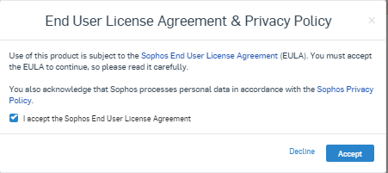
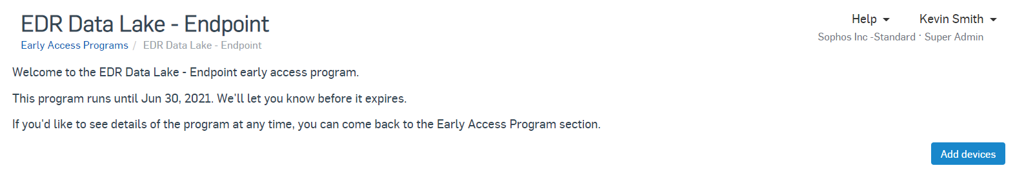
2. Entering the Early Access Program
You must check the box to Accept the License agreement and acknowledge the Privacy policy. License Agreement
Click ‘Accept’ to continue
On the Welcome page, click the ‘Add Devices’ button to proceed

Slide 9
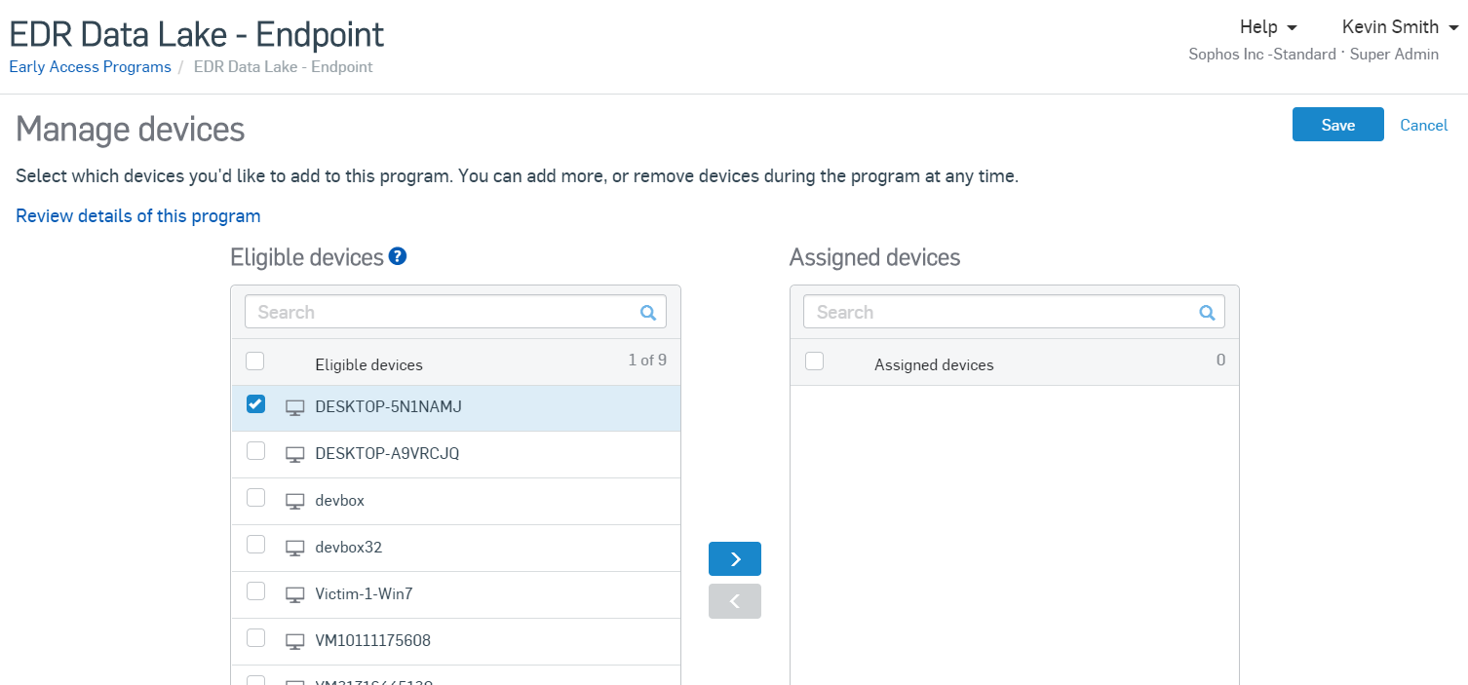
3. Manage devices and confirm deployment
You can now see a list of eligible devices and those which are assigned to the Early Access program
To assign a device to the EAP click on it and then click on
When you are finished, click on Save
Note: We encourage customers to enroll devices slowly to ensure all is working okay. Devices can only be enrolled in one EAP at a time, so devices enrolled in the New Endpoint/Server Protection and EDR Features' early access program won’t be listed as eligible for this EAP

Slide 10
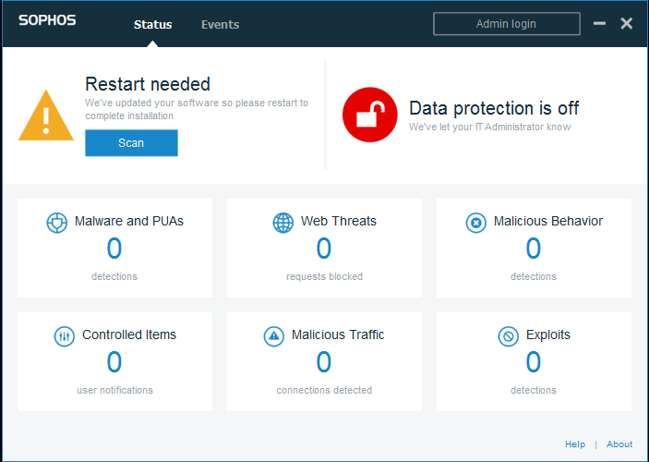
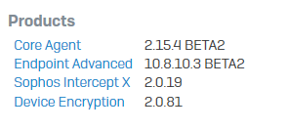
3. Manage devices and confirm deployment
Once components are updated on assigned devices, and depending on the new functionality, you may be prompted to restart the device to finish the update
Once restarted, you can confirm a successful update by clicking the Sophos Agent Icon in the system tray and clicking the About link in the bottom right hand corner
You should verify the version of components is correct for the new functionality as documented.
At this point enrolled devices should now be sending data to the EDR Data Lake

Slide 11
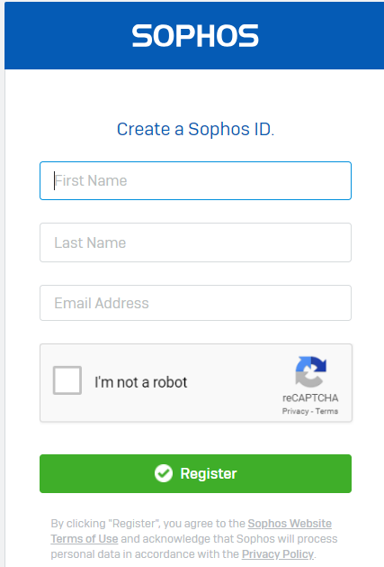
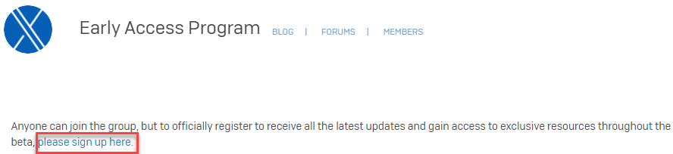
Next steps - join the Sophos Community
The EDR Data Lake community will be used to discuss issues, provide feedback and share information and content throughout the EAP
If not already a member, create a Sophos Community account here:
https://id.sophos.com/web/register/
Then visit the EDR Data Lake community:
https://community.sophos.com/intercept-x-endpoint/edr-data-lake-eap/
API documentation, a test tool, and instructions on connecting to the APIs to query the EDR Data Lake are available on the community

Slide 12
Have questions or want to give feedback?
Please leverage discussion forum in the Sophos EDR Data Lake Early Access Community:
https://community.sophos.com/intercept-x-endpoint/edr-data-lake-eap/f/discussions

