Slide 1
Sophos “New Endpoint Protection and EDR Features” and “New Server Protection and EDR Features”
Early Access Program

Slide 2
Summary
The “New Endpoint Protection and EDR Features” and “New Server Protection and EDR Features” Early Access Programs allow customers to test the latest and greatest endpoint features and functionality as they are being developed by Sophos.
Existing Central customers looking to trial these capabilities must join one or both Early Access Programs to access these features
Unless otherwise stated new features will only be available to devices enrolled in the Early Access program
New customers can start a new Sophos Central Endpoint or Server trial and then enrol into the Early Access Program(s) for those products to get access to features in EAP
The latest features available to the Early Access Program can be found in the Sophos Community Blog Post here
Three activities are required to join early access program
  Prepare devices
  Enter the Early Access Program(s) in Sophos Central
  Manage Devices and Confirm deployment
This deck provides assistance to undertake these activities
Note: Use of all features and functionalities provided under the Early Access Program is subject to the Sophos End User License Agreement

Slide 3
1. Prepare devices
Check list for qualifying devices
  Devices eligible to be deployed to the early access program must be running the Central Endpoint or Server software.
  Devices should have a Green health status displayed in your Sophos Central console

Slide 4
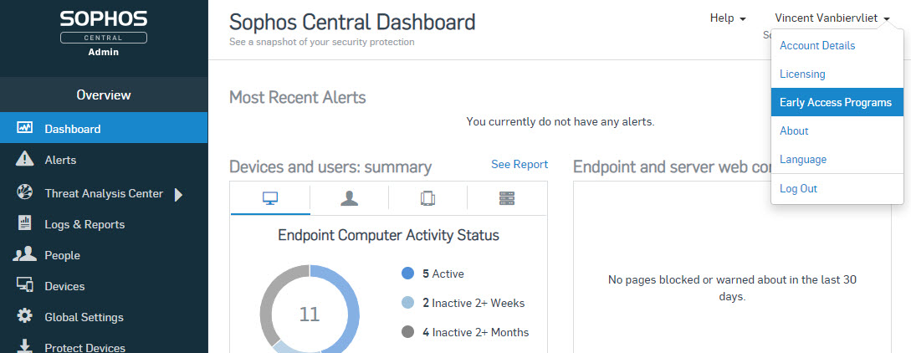
2. Entering the Early Access Program
Log into Sophos Central
Click on your name at the top right corner
Click on Early Access Programs

Slide 5
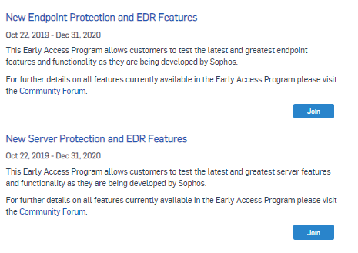
2. Entering the Early Access Program
You will now see the Early Access Programs screen
Depending on the EAP you want to join, select the “New Endpoint Protection and EDR Features” or the “New Server Protection and EDR Features” EAP
Click the button to Join the EAP

Slide 6
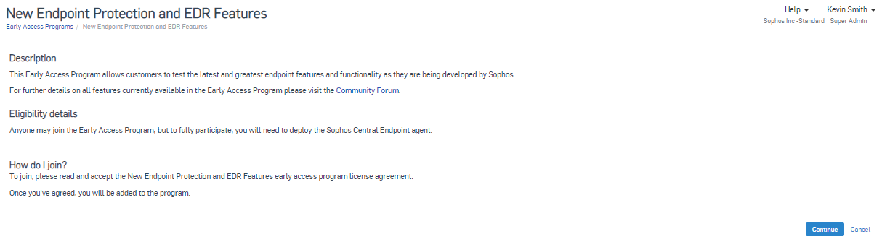
2. Entering the Early Access Program
Click Continue on the New Endpoint or Server Protection Features description page

Slide 7
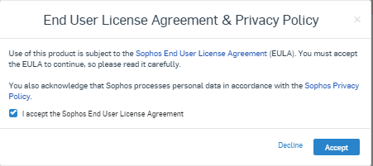
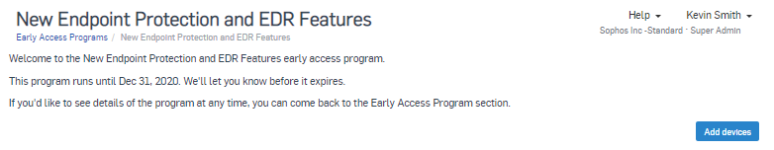
2. Entering the Early Access Program
You must check the box to Accept the License agreement and acknowledge the Privacy policy. License Agreement
Click ‘Accept’ to continue
On the Welcome page, click the ‘Add Devices’ button to proceed

Slide 8
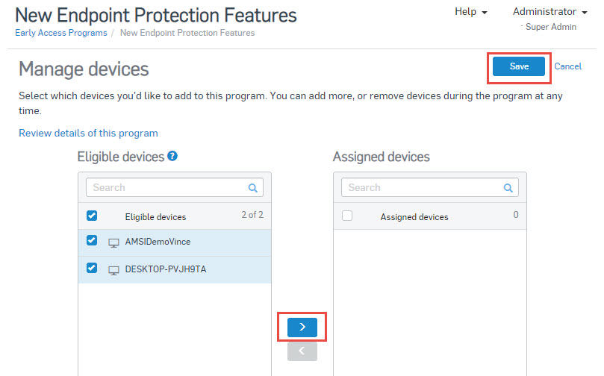
3. Manage devices and confirm deployment
You can now see a list of eligible devices and those which are assigned to the Early Access program
To assign a device to the EAP click on it and then click on
When you are finished, click on Save

Slide 9
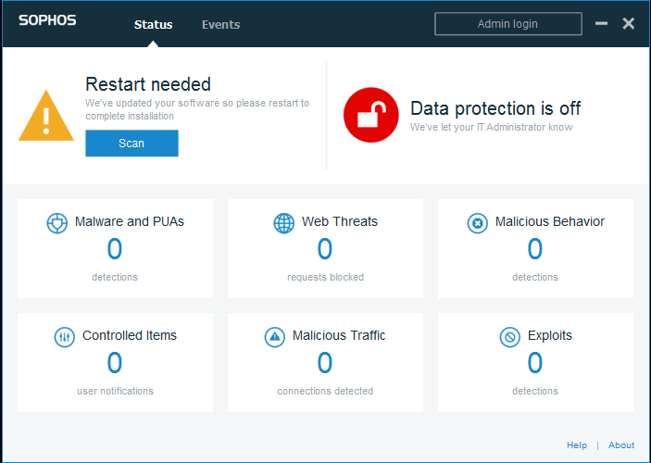
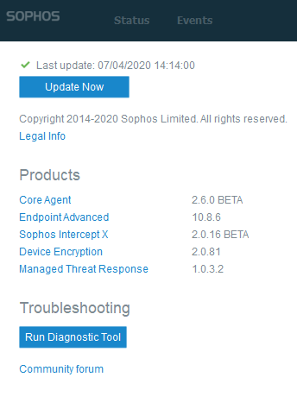
3. Manage devices and confirm deployment
Once Endpoint components are updated on assigned endpoints, and depending on the new functionality, you may be prompted to restart the endpoint to finish the update
Once restarted, you can confirm a successful update by clicking the Sophos Agent Icon in the system tray and clicking the About link in the bottom right hand corner
You should verify the version of components is correct for the new functionality as documented.

Slide 10
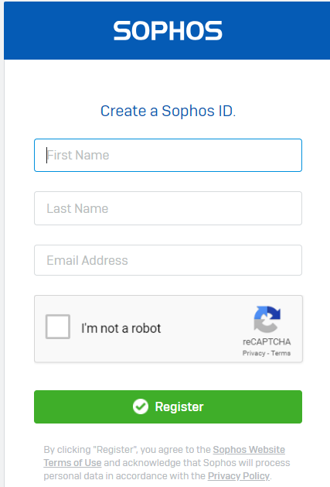
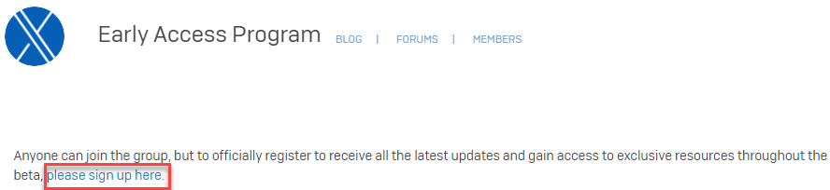
Next steps - join the New Endpoint/Server Protection Features Early Access Preview community
The New Endpoint/Server Protection Features Early Access Preview community will be used to discuss issues (via EDR forum), provide feedback and share information and content throughout the EAP
If not already a member, create a Sophos Community account:
https://id.sophos.com/web/register/
Then sign up to the New Endpoint/Server Protection Features EAP Community: https://community.sophos.com/products/intercept/early-access-preview

Slide 11
Have questions or want to give feedback?
Leverage the Sophos Endpoint Early Access Community where we’ll be providing blogs, videos documentation and forums where we’ll be sharing information and answering your technical questions. Via the Intercept X EAP community: https://community.sophos.com/products/intercept/early-access-preview

