Slide 1
Sophos Endpoint Detection and Response Early Access Program

Slide 2
Summary
Early Access Program is now using the generally available Endpoint Detection and Response endpoint software
Existing Central customers looking to trial EDR capabilities must join the Early Access program to access these features
New customers can start a new Sophos Central trial where Intercept X Advanced with EDR will be provided as part of that trial
Three activities are required to join early access program
Prepare devices
Enter the Early Access Program in Sophos Central
Manage Devices and Confirm deployment
This deck provides assistance to undertake these activities

Slide 3
1. Prepare devices
Check list for qualifying devices
Must be running on supported Operating Systems:
Windows 7 , 8 , 8.1 , 10 operating system
32bit or 64 bit
Endpoints eligible to be deployed to the early access must be running Central Endpoint Advanced and Intercept X
Endpoints must have a Green health status displayed in your Sophos Central console

Slide 4
2. Entering the Early Access Program
Log into Sophos Central
Click on your name at the top right corner
Click on Early Access Programs

Slide 5
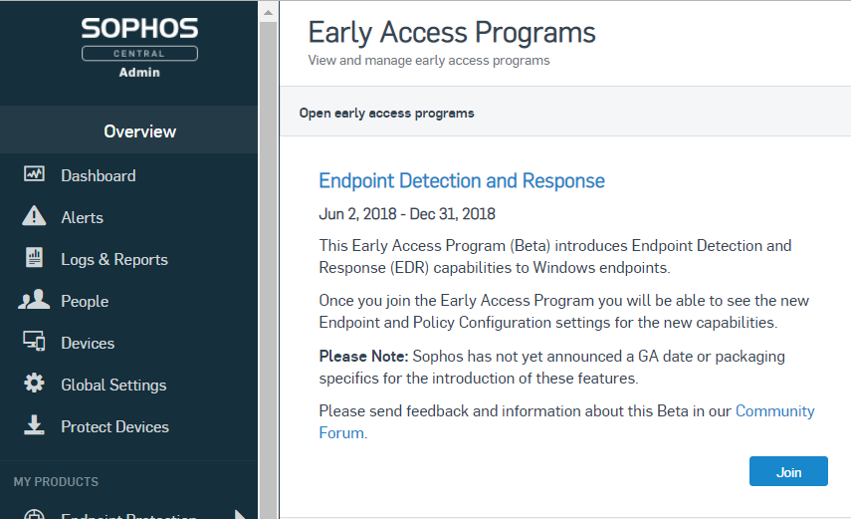
2. Entering the Early Access Program
You will now see the Early Access Programs screen
Click the button to Join the Early Access Program

Slide 6
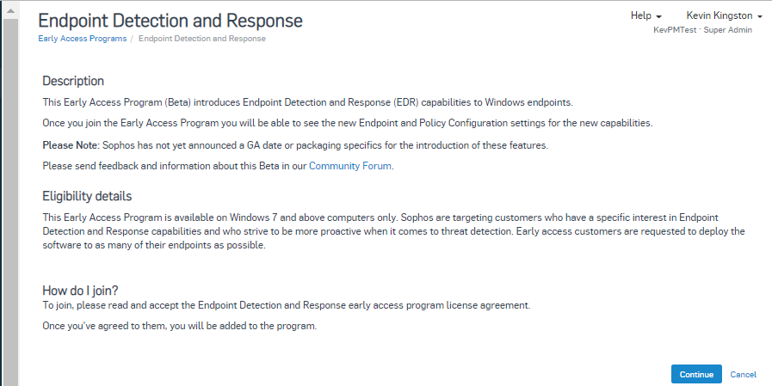
2. Entering the Early Access Program
Click Continue on the Endpoint Detection and Response description page

Slide 7
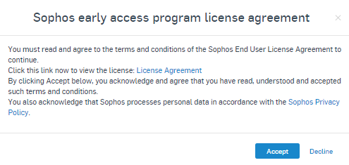
2. Entering the Early Access Program
You must click the ‘License Agreement’ link to read the Sophos End-user License Agreement
Click ‘Accept’ to continue
On the Welcome page, click the ‘Add Devices’ button to proceed

Slide 8
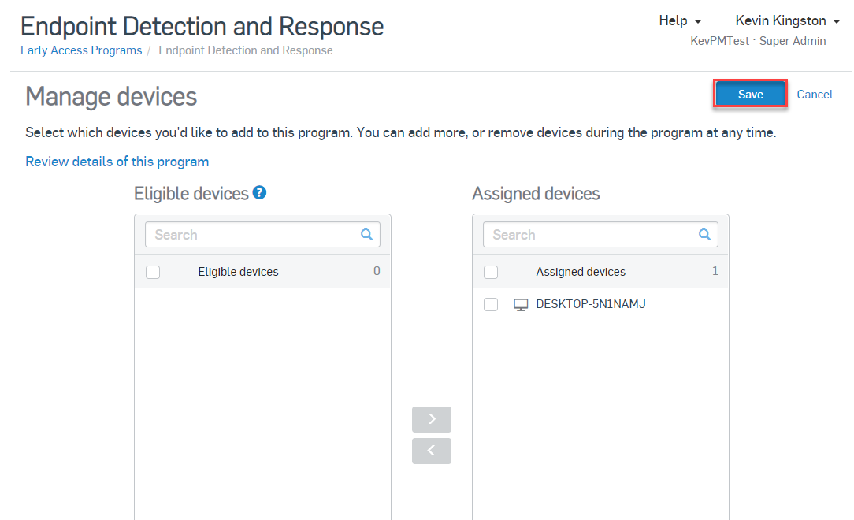
3. Manage devices and confirm deployment
You can now see a list of eligible devices and those which are assigned to the Early Access program
To assign a device to the EAP click on it and then click on
When you are finished, click on Save

Slide 9
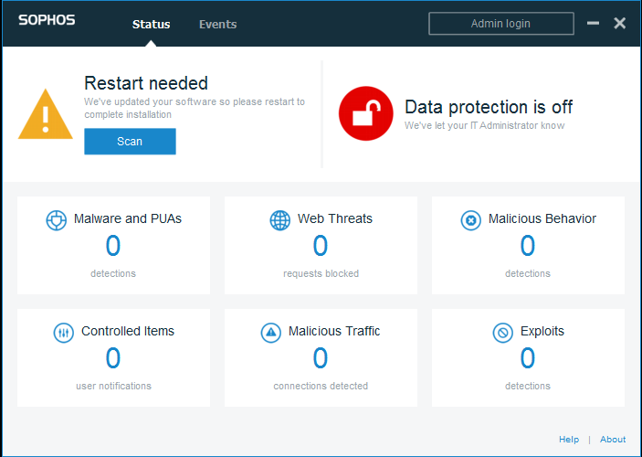
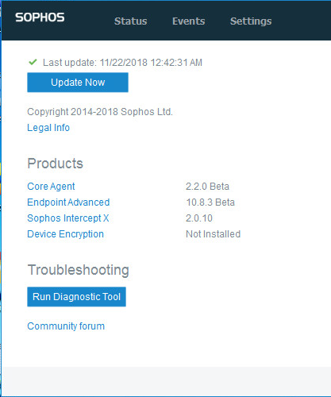
3. Manage devices and confirm deployment
Once Endpoint components are updated on assigned endpoints, you will be prompted to restart the endpoint to finish the update
Once restarted, you can confirm a successful update by clicking the Sophos Agent Icon in the system tray and clicking the About link in the bottom right hand corner
You should see the Core Agent is now running the 2.2.0 Beta version

Slide 10
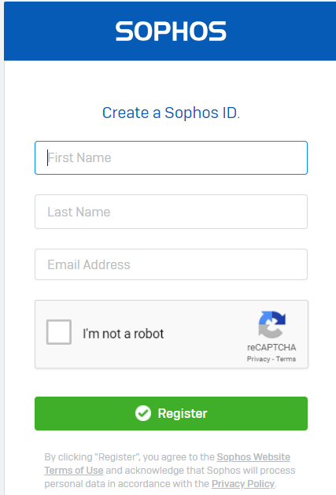
Next steps - join the Intercept X Early Access Preview community
The Intercept X Early Access Preview community will be used to discuss issues (via EDR forum), provide feedback and share information and content throughout the EAP
If not already a member, create a Sophos Community account:
https://id.sophos.com/web/register/
Then sign up to the Intercept X EAP Community: https://community.sophos.com/products/intercept/early-access-preview

Slide 11
Need to provide feedback now?
Via the Intercept X EAP community: https://community.sophos.com/products/intercept/early-access-preview

