Slide 1
Sophos Endpoint Detection and Response Early Access Program

Slide 2
Summary
Three activities are required to participate in the beta release
  Prepare devices
  Enter the Early Access Program in Sophos Central
  Manage Devices and Confirm deployment
This deck provides assistance to undertake these activities

Slide 3
1. Prepare devices
Check list for qualifying devices
  Must be running on supported Operating Systems:
    Windows 7 , 8 , 8.1 , 10 operating system
    32bit or 64 bit
  Endpoints eligible to be deployed for early access must be running Central Endpoint Advanced and Intercept X
  Endpoints must have a Green health status displayed in your Sophos Central console
  Due to a change in how the endpoint agent monitors and logs system changes, Sophos are recommending that Endpoints enrolled in the Early Access program have a minimum of 15GB of free hard disk space available

Slide 4
2. Entering the Early Access Program
Log into Sophos Central
Click on your name at the top right corner
Click on Early Access Programs

Slide 5
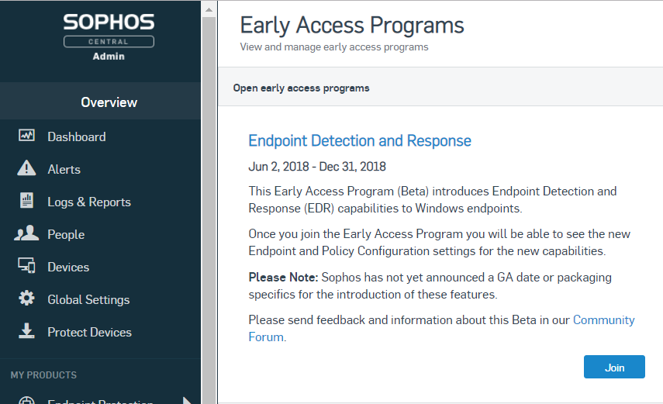
2. Entering the Early Access Program
You will now see the Early Access Programs screen
Click the button to Join the Early Access Program

Slide 6
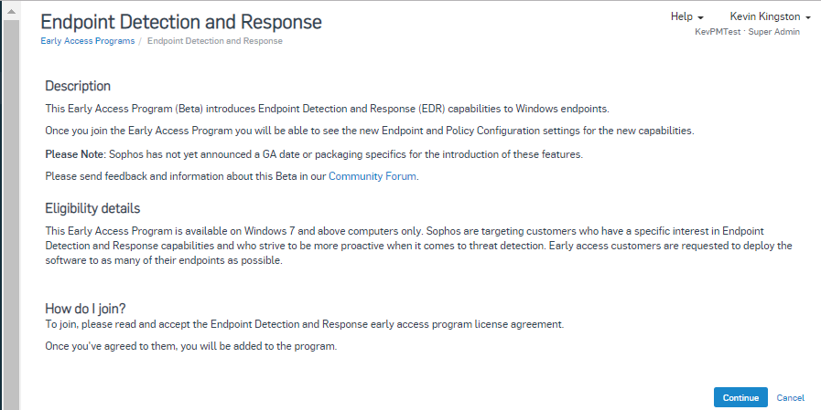
2. Entering the Early Access Program
Click Continue on the Endpoint Detection and Response description page

Slide 7
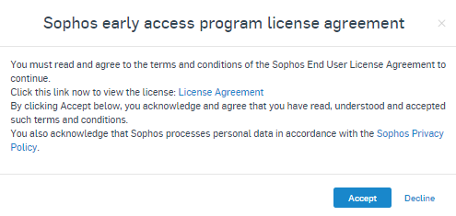
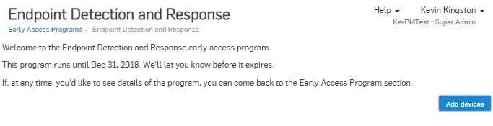
2. Entering the Early Access Program
You must click the ‘License Agreement’ link to read the Sophos End-user License Agreement
Click ‘Accept’ to continue
On the Welcome page, click the ‘Add Devices’ button to proceed

Slide 8
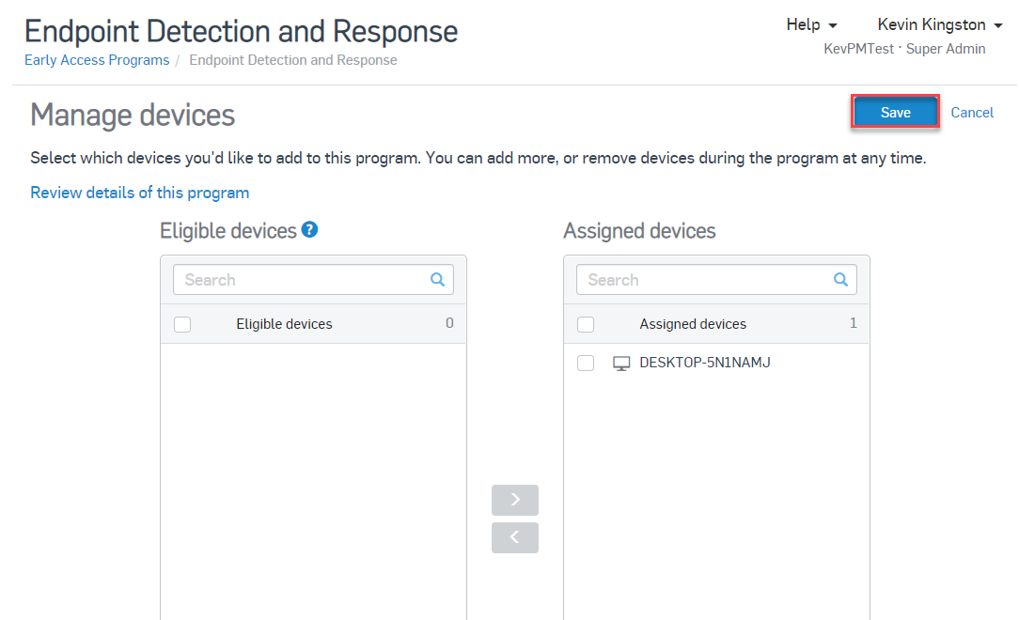
3. Manage devices and confirm deployment
You can now see a list of eligible devices and those which are assigned to the beta
To assign a device to the beta, click on it and then click on
When you are finished, click on Save

Slide 9
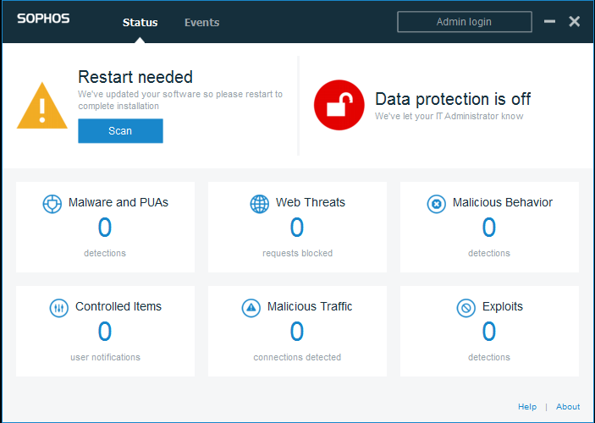
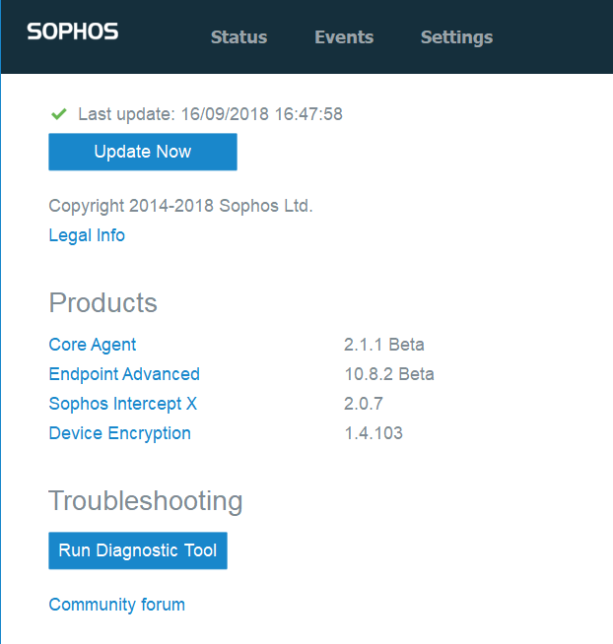
3. Manage devices and confirm deployment
Once Endpoint components are updated on assigned endpoints, you will be prompted to restart the endpoint to finish the update
Once restarted, you can confirm a successful update by clicking the Sophos Agent Icon in the system tray and clicking the About link in the bottom right hand corner
You should see the Core Agent is now running the 2.1.1 Beta version

Slide 10
Known Issues and Important Info
Due to planned changes in how the endpoint agent monitors and logs system changes, Sophos are recommending that Endpoints enrolled in the Early Access program have a minimum of 15 GB of free hard disk space available. These log files could theoretically grow to take up 37.5 GB of disk space but this would be highly unlikely.
The Clean and Block action will apply to portable executable files only and will not apply to PE files that have a good reputation according to Sophos.
When the Clean and Block action is applied and a SHA-256 hash is added to the Blocked Items list, that list will apply to all endpoints regardless of whether they are assigned to the EAP or not.

Slide 11
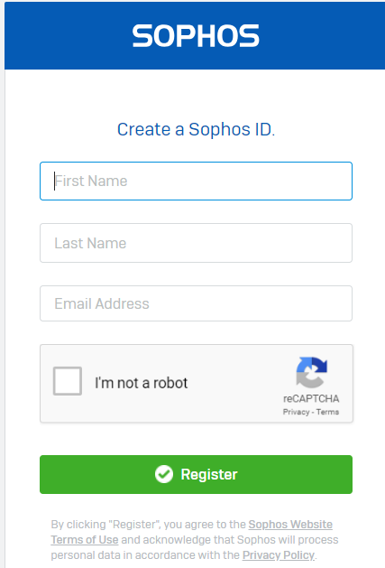
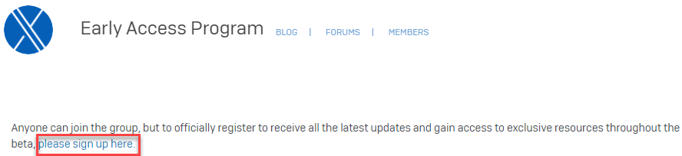
Next steps - join the Intercept X Early Access Preview community
The Intercept X Early Access Preview community will be used to discuss issues (via EDR forum), provide feedback and share information and content throughout the EAP
If not already a member, create a Sophos Community account:
https://id.sophos.com/web/register/
Then sign up to the Intercept X EAP Community: https://community.sophos.com/products/intercept/early-access-preview

Slide 12
Need to provide feedback now?
Via the Intercept X EAP community: https://community.sophos.com/products/intercept/early-access-preview
Email interceptbeta@sophos.com

