Slide 1
XDR/MTR
Microsoft Graph Security
Sophos Confidential

Slide 2
Topics to cover in 30min Sophskills
Questions
  Email us at mtreap2@sophos.com
Release
  EAP Start of June
  GA Start of July
License
  Included with MTR Advanced
Value
  Alert notification for MTR security team and customer
  Context and exploration of details with Queries
Demo
  MTR Community Forum
  Enable/configure
  Alert overview/queries

Slide 3
Microsoft Graph Security
For MTR Accounts
Sophos license
  MTR Advanced license required for use by Sophos MTR
  XDR EAP will be available in CQ3 to enable the display of MS Graph Security Detections and investigations in the Sophos Central console
Central Adaptor configuration
  Requires authorization for access to MS Graph Security events
MS Graph Security events are sent to the Sophos data lake
  Each event will evaluated by Sophos to assign an appropriate risk score for the event and generate detection and case information for the Sophos MTR team

Slide 4
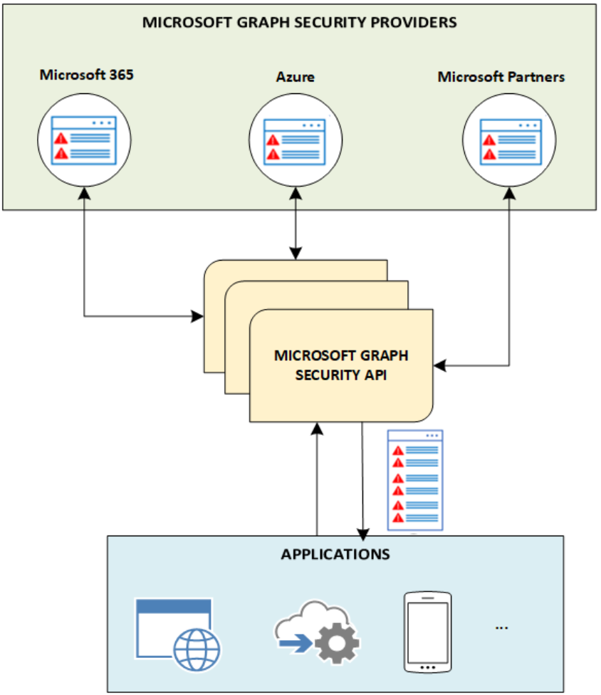
Alert sources
Alerts are potential security issues within a customer’s environment that Microsoft or partner security solutions have identified and flagged for action or notification.
Security provider | GET alert
Microsoft Defender for Cloud | ✓
Azure Active Directory Identity Protection | ✓
Microsoft Defender for Cloud Apps | ✓
Microsoft Defender for Endpoint | ✓
Microsoft Defender for Identity | ✓
Microsoft 365 Default Cloud App Security Custom Alert | ✓
Azure Information Protection (preview) | ✓
Azure Sentinel (preview) | ✓
Sophos Central
Security alerts are triggered by advanced detections and are available only with enhanced security features enabled.
SEE ALSO: https://docs.microsoft.com/en-us/azure/defender-for-cloud/alerts-reference

Slide 5
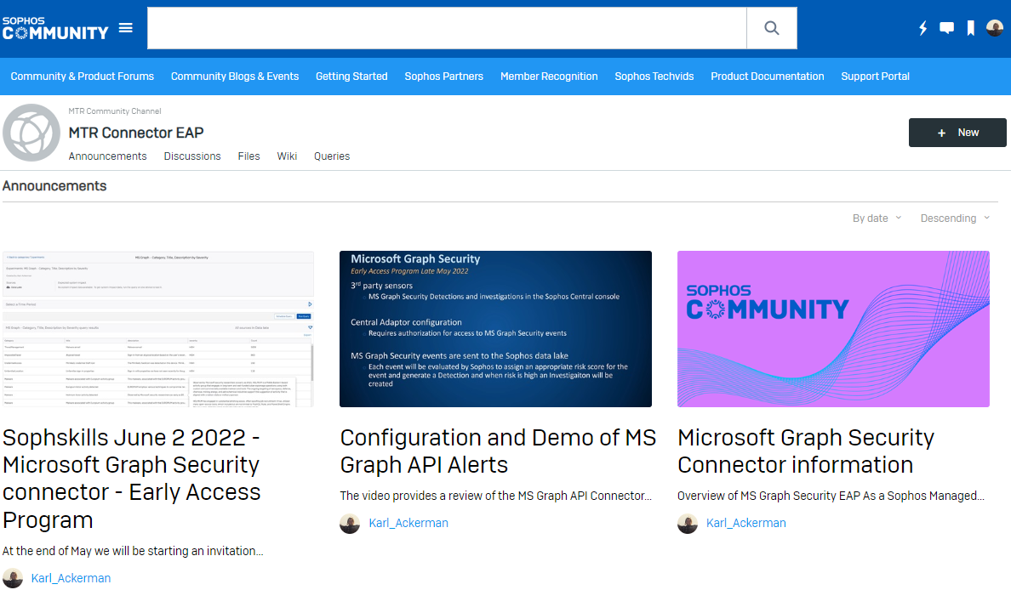
Sophos Community
MTR Connector EAP - Community
https://community.sophos.com/mdr-community-channel/mtr-connector-eap/
Video - Setup and Testing
https://community.sophos.com/cfs-file/__key/telligent-evolution-videotranscoding-securefilestorage/communityserver-blogs-components-weblogfiles-00-00-00-00-90/MS-Graph-V2.mp4.mp4
Announcements
Discussion
Queries

Slide 6
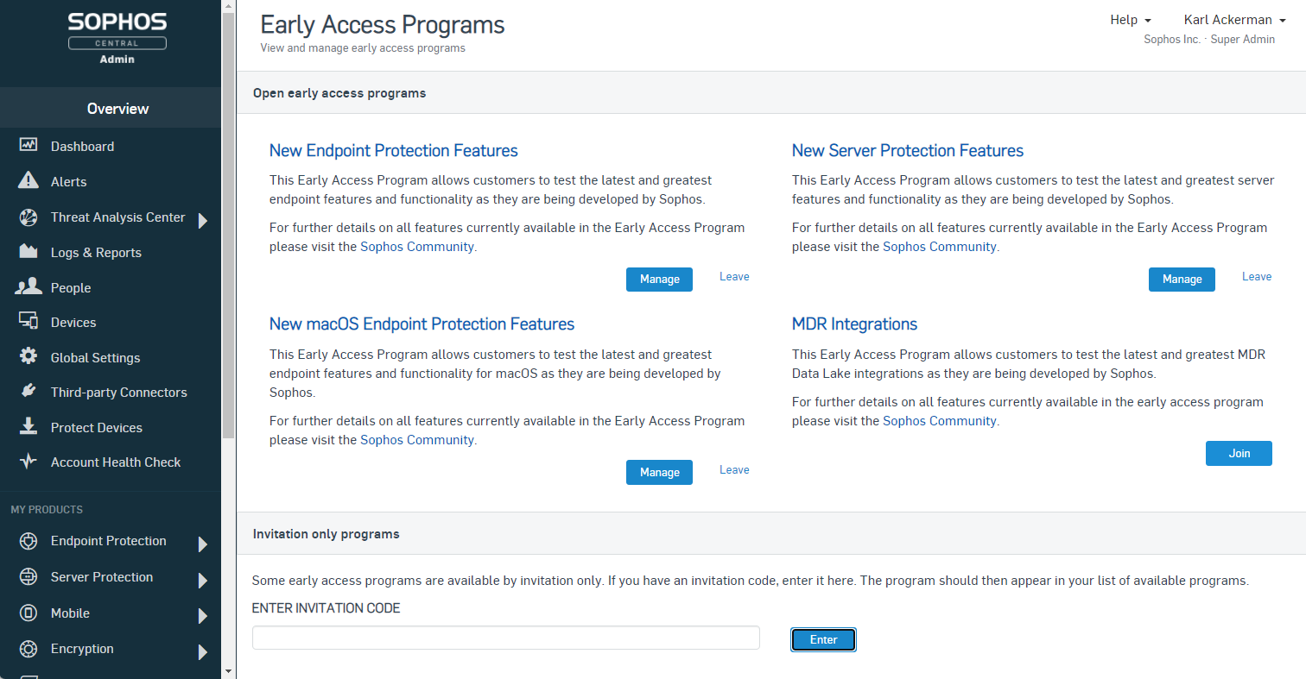
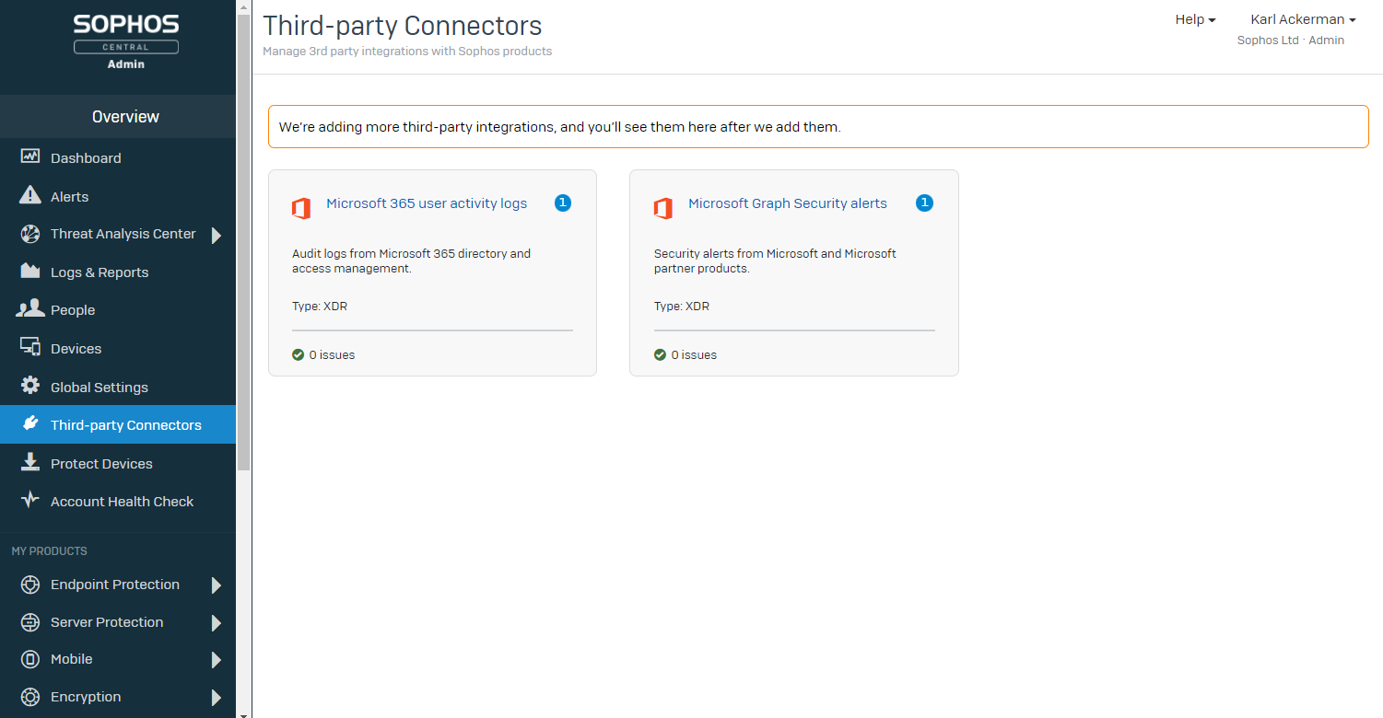
Enable the Connector
An invitation key is required to join the EAP
  MTR Advanced accounts are qualified
  Email mtreap2@sophos.com to request access to the EAP
Enable the connector from Sophos Central
Visit the Sophos MTR community forum for more information and sample queries
  https://community.sophos.com/mdr-community-channel/mtr-connector-eap/i/queries

Slide 7
DEMO

Slide 8
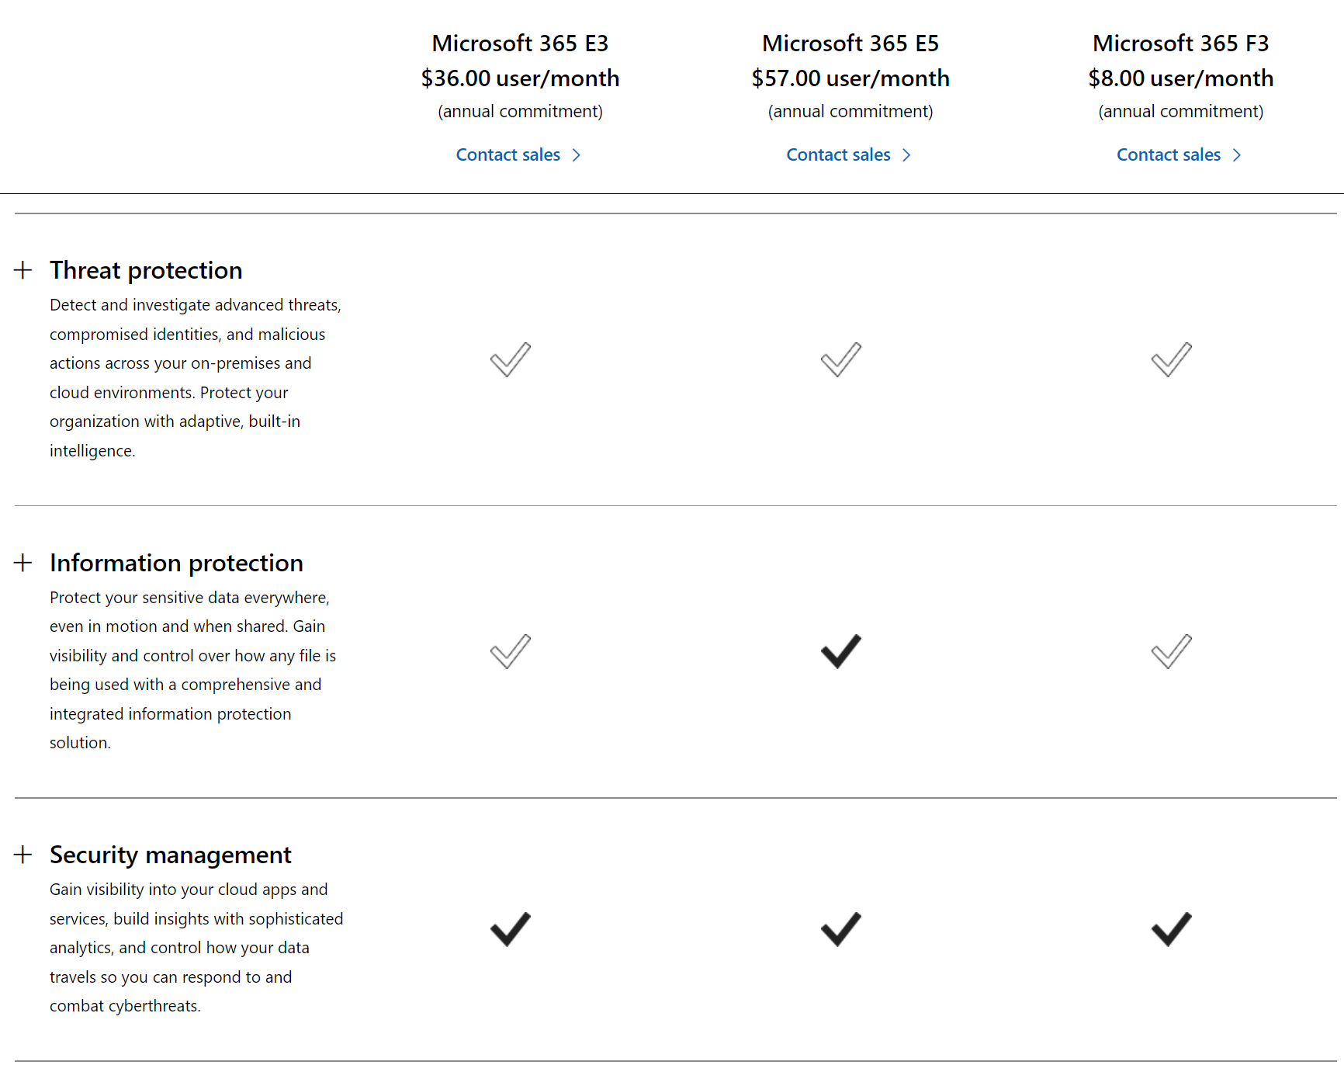
Microsoft 365 License
https://www.microsoft.com/en-us/microsoft-365/compare-microsoft-365-enterprise-plans

Slide 9
Microsoft 365 Defender License requirements
Any of these licenses gives you access to Microsoft 365 Defender features via the Microsoft 365 Defender portal without additional cost:
  Microsoft 365 E5 or A5
  Microsoft 365 E3 with the Microsoft 365 E5 Security add-on
  Microsoft 365 E3 with the Enterprise Mobility + Security E5 add-on
  Microsoft 365 A3 with the Microsoft 365 A5 Security add-on
  Windows 10 Enterprise E5 or A5
  Windows 11 Enterprise E5 or A5
  Enterprise Mobility + Security (EMS) E5 or A5
  Office 365 E5 or A5
  Microsoft Defender for Endpoint
  Microsoft Defender for Identity
  Microsoft Defender for Cloud Apps
  Defender for Office 365 (Plan 2)

Slide 10
Azure Active Directory Identity Protection
Capability | Details | Azure AD Free / Microsoft 365 Apps | Azure AD Premium P1 | Azure AD Premium P2
Risk policies | User risk policy (via Identity Protection) | No | No | Yes
Risk policies | Sign-in risk policy (via Identity Protection or Conditional Access) | No | No | Yes
Security reports | Overview | No | No | Yes
Security reports | Risky users | Limited Information. Only users with medium and high risk are shown. No details drawer or risk history. | Limited Information. Only users with medium and high risk are shown. No details drawer or risk history. | Full access
Security reports | Risky sign-ins | Limited Information. No risk detail or risk level is shown. | Limited Information. No risk detail or risk level is shown. | Full access
Security reports | Risk detections | No | Limited Information. No details drawer. | Full access
Notifications | Users at risk detected alerts | No | No | Yes
Notifications | Weekly digest | No | No | Yes
 | MFA registration policy | No | No | Yes
https://docs.microsoft.com/en-us/azure/active-directory/identity-protection/overview-identity-protection

Slide 11
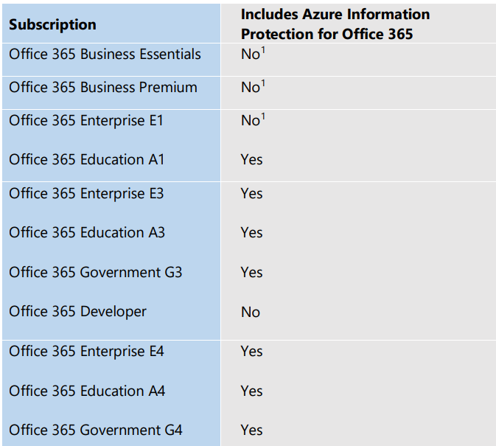
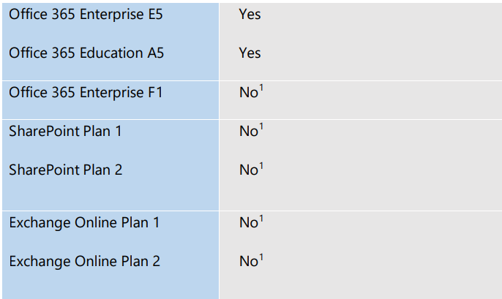
Azure information protection
1 Azure Information Protection-based protection capabilities are not included in these plans, but Azure Information Protection for Office 365 can be purchased as a separate add-on and will enable the supported protection features. You can find a more detailed table describing the protection features included in Office 365, Azure Information Protection P1 and Azure Information Protection P2 here.
https://download.microsoft.com/download/E/C/F/ECF42E71-4EC0-48FF-AA00-577AC14D5B5C/Azure_Information_Protection_licensing_datasheet_EN-US.pdf

Slide 12
Microsoft Sentinel
Microsoft Sentinel pricing is based on analytics logs that support all data types and offer full analytics, alerts and no query limits. There are two ways to pay for the Microsoft Sentinel Service: Commitment Tiers and Pay-As-You-Go.
https://azure.microsoft.com/en-us/pricing/details/microsoft-sentinel/

