Slide 1
Sophos “New Endpoint Protection Features” and “New Server Protection Features”
Early Access Program

Slide 2
Summary
The “New Endpoint Protection Features” and “New Server Protection Features” Early Access Programs are adding AMSI Protection and Malicious Network Traffic Prevention (IPS) to Windows endpoints and servers
Existing Central customers looking to trial these capabilities must join one or both Early Access Programs to access these features
New customers can start a new Sophos Central trial where Intercept X Advanced with EDR, including AMSI Protection and Malicious Network Traffic Prevention, will be provided as part of that trial
Three activities are required to join early access program
  Prepare devices
  Enter the Early Access Program(s) in Sophos Central
  Manage Devices and Confirm deployment
This deck provides assistance to undertake these activities

Slide 3
1. Prepare devices
Check list for qualifying devices
  Must be running on supported Operating Systems:
    AMSI
      Windows 10 (32/64-bit)
        Different AMSI Protection features may require different minimum Windows 10 versions
      32bit or 64 bit
      Windows Server 2016 or later
    Malicious Network Traffic Prevention (IPS)
      Windows 8.1, Windows 10 (32/64-bit)
      Windows Server 2012 or later
  Endpoints eligible to be deployed to the early access must be running Central Endpoint Advanced and Intercept X
  Endpoints must have a Green health status displayed in your Sophos Central console

Slide 4
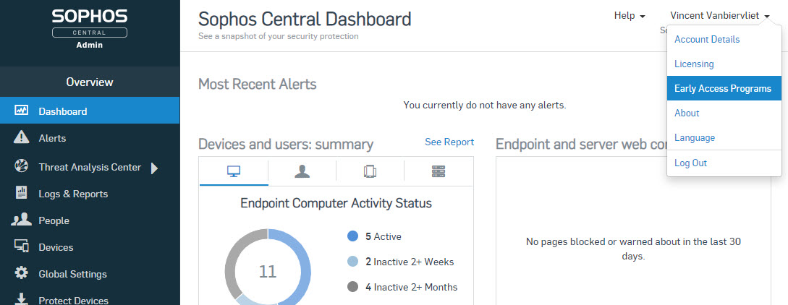
2. Entering the Early Access Program
Log into Sophos Central
Click on your name at the top right corner
Click on Early Access Programs

Slide 5
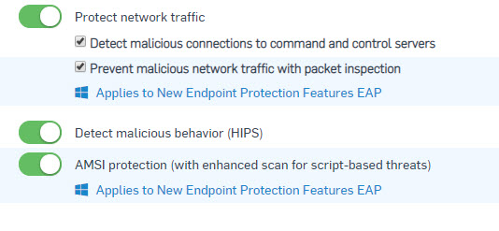
2. Entering the Early Access Program
Alternatively, click the link in the “Protect Network Traffic” or “AMSI protection” settings

Slide 6
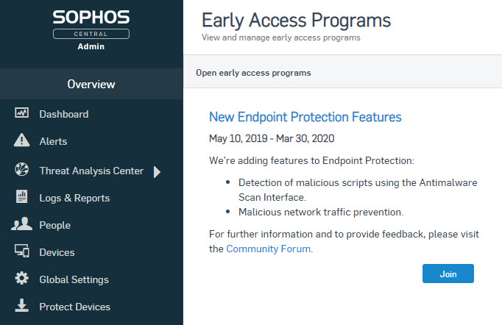
2. Entering the Early Access Program
You will now see the Early Access Programs screen
Depending on the EAP you want to join, select the “New Endpoint Protection Features” or the “New Server Protection Features” EAP
Click the button to Join the EAP

Slide 7
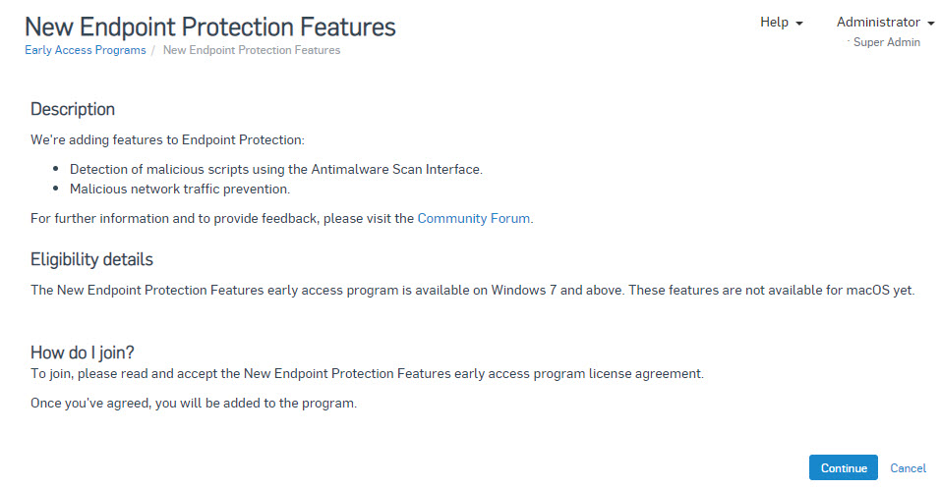
2. Entering the Early Access Program
Click Continue on the New Endpoint or Server Protection Features description page

Slide 8
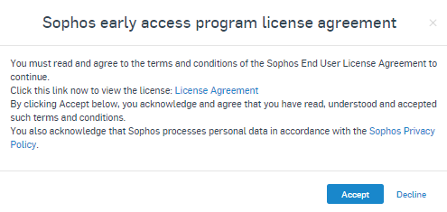
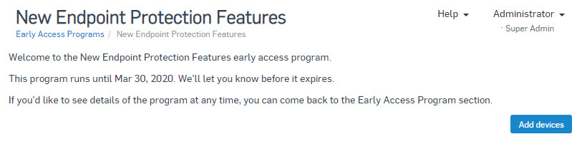
2. Entering the Early Access Program
You must click the ‘License Agreement’ link to read the Sophos End-user License Agreement
Click ‘Accept’ to continue
On the Welcome page, click the ‘Add Devices’ button to proceed

Slide 9
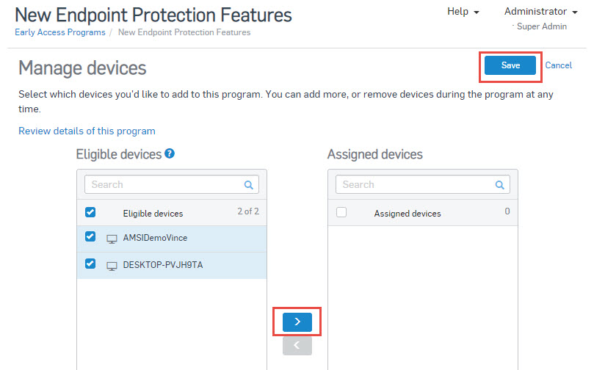
3. Manage devices and confirm deployment
You can now see a list of eligible devices and those which are assigned to the Early Access program
To assign a device to the EAP click on it and then click on
When you are finished, click on Save

Slide 10
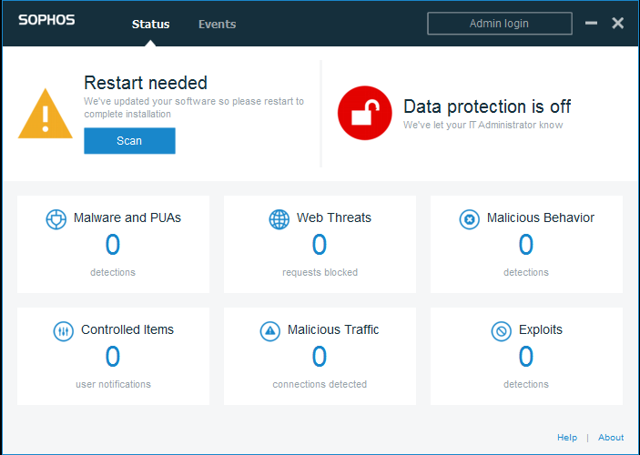
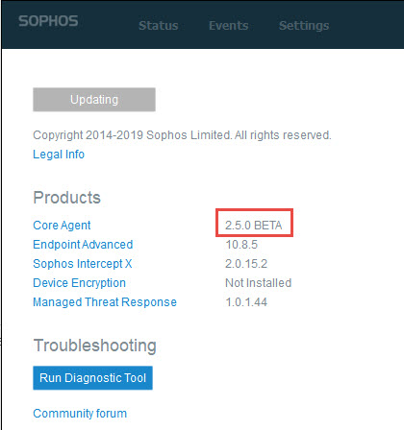
3. Manage devices and confirm deployment
Once Endpoint components are updated on assigned endpoints, you will be prompted to restart the endpoint to finish the update
Once restarted, you can confirm a successful update by clicking the Sophos Agent Icon in the system tray and clicking the About link in the bottom right hand corner
You should see the Core Agent is now running the 2.5.0 Beta version

Slide 11
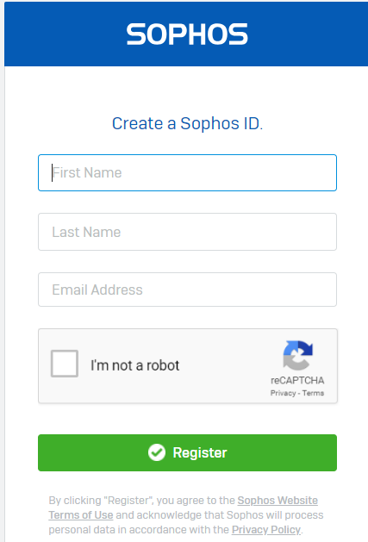
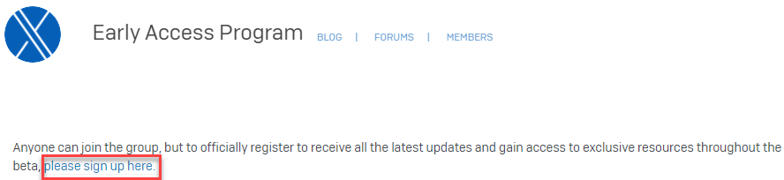
Next steps - join the New Endpoint/Server Protection Features Early Access Preview community
The New Endpoint/Server Protection Features Early Access Preview community will be used to discuss issues (via EDR forum), provide feedback and share information and content throughout the EAP
If not already a member, create a Sophos Community account:
https://id.sophos.com/web/register/
Then sign up to the New Endpoint/Server Protection Features EAP Community: https://community.sophos.com/products/intercept/early-access-preview

Slide 12
Need to provide feedback now?
Via the Intercept X EAP community: https://community.sophos.com/products/intercept/early-access-preview

